Slide 1
Leading Strategic Change in Higher Education
Professor Zahir Irani, Dean and Head of Brunel Business School
HPLP (Harvard), PhD (Brunel), MPhil (Salford), B.Eng (Hons) (Salford)

Slide 2
Defining Leadership
Leading People
Influencing People
Commanding People
Guiding People
5

Slide 3
Defining Leadership
Leadership is a means of directing i.e. is concerned with a sense of direction and vision and the delivery of that vision
Leadership involves working with others, probably in teams, and the maintenance of relationship
Leadership is careful and relentless process that involves attention to details
6

Slide 4
Defining Leadership
A leader’s actions are devoted to helping a group to attain its objectives
Leadership is the ability of management to induce subordinates to work towards group goals with confidence
Leadership is not about managing things but about developing people
The Basement
7

Slide 5
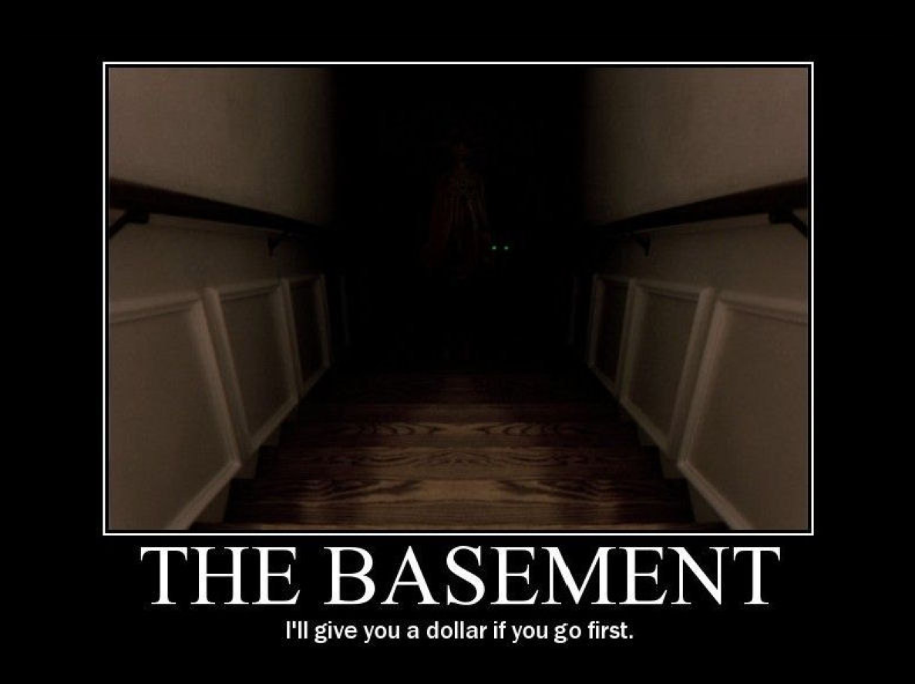

Slide 6
Defining Leadership
Leadership has been defined as:
“process of social influence in which one person can enlist the aid and support of others in the accomplishment of a common task”
“Leadership is ultimately about creating a way for people to contribute to making something extraordinary happen”
9

Slide 7
Mandela’s 8 Lessons of Leadership
Courage is not the Absence of Fear
Courage is not the absence of fear – it’s inspiring others to move beyond it
  You cannot pretend that you are brave and that you can beat the whole world
  But as a leader, you cannot let people know – you must put up a front
Lead from the Front – but do not leave your base behind
  Communicate your strategy with each member of your group – take your support base with your
Lead from the Back – and let others believe that they are in front
  Do not enter the debate to early - only after all had spoken do the king begins to speak
  It is wise to persuade people to do things and make them think it was their own idea
Know your Competitor – and learn about his favourite sport
  By speaking your opponent’s language you might understand their strengths and weaknesses and formulate tactics accordingly
Keep your friends close – and your rivals even closer
  Embracing your rivals is a way of controlling them
  Competitors are more dangerous on their own than within your circle of influence
  Cherish loyalty but taking into consideration that people act in their own interest
Appearance matters – and remember to smile
  Forget the past – the smile is the message
Nothing is Black or White – why not both?
  Life is never either/or
  Decisions are complex, there are always competing factors – nothing is ever straightforward as it appears
  11
Quitting is Leading too
  Knowing how to abandon a failed idea/task is often the most difficult kind of decision a leader has to make00
Quitting is Leading too
Lead from the Front
Leadership
Nothing is Black or White
Lead from the Back
Appearances
Matter
Know your Competitor
Keep your Friends close – and Rivals even Closer
Lead
10

Slide 8
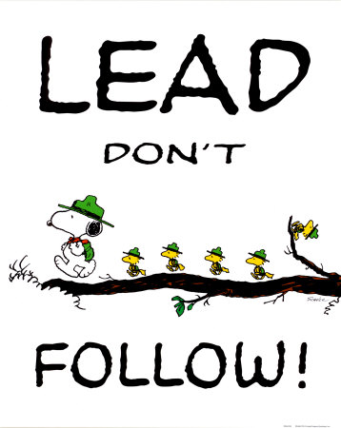

Slide 9
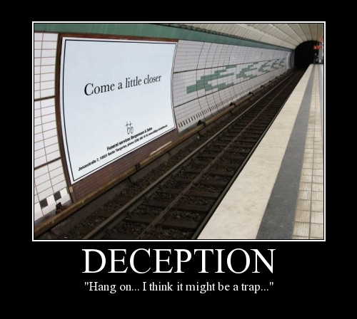
So Who is a Great Leader?
Live with integrity, lead by example
Develop a winning strategy or “big idea”
Build a great management team
Inspire employees to greatness
Create a flexible, responsive organisation
Use reinforcing management systems
12

Slide 10
So Who is a Great Leader?
Passionate about what they do
Love to talk about it
High energy
Clarity of thinking
Communicate to diverse audience
Work through people (empowering)
13

Slide 11
Characteristics of Leadership
A leader needs a clear and challenging vision – which he/she will define, a magic with words, the ability to motivate others, the courage to stay on course and the persistence not to lose hope
So what are the characteristics of an individual leader?
14

Slide 12
Characteristics of Leadership
  Intelligence, and a desire to solve complex problems or discover patterns in events
  Initiative, and the ability to perceive the need for action and to do something about it; this is often related to energy and stamina
  Self-assurance, and self-confidence to believe in what they/you are doing; this is related to the individual’s perception of their role in society and aspirations
  The helicopter trait, which is a descriptive term for the ability to understand a situation at different levels of detail
Leadership
15

Slide 13
Skills of a Leader
The basic aim of the leader is to succeed in completing the task set with the help of his/her group
An effective leader will need to inspire confidence and trust so that there is maximum cooperation from the group
To achieve the above, leader needs certain skills e.g.:
17

Slide 14
Skills of a Leader
  Sufficient knowledge of the set task to be able to lead the group effectively
  Knowledge of the group, their skills and their weaknesses
  Understanding of the precise requirements needed from the group
  Ability to communicate clearly and succinctly
  Ability to make decisions, sometimes under pressure
  An understanding of human nature to appreciate that attitude of the group
  Ability to motivate the group
Leadership
18

Slide 15
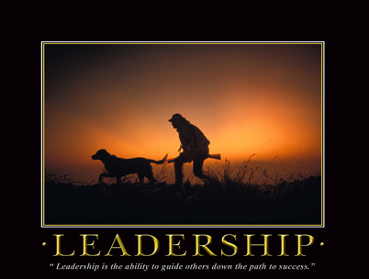

Slide 16

Exercise for Impact
Kindly stand up & close your eyes
What do you believe is the point of this exercise?
20

Slide 17
Leading the Way
The purpose of the exercise is to highlight the importance of having a leader who points everybody in the same direction to achieve team/business success
21

Slide 18
Factors Affecting Leadership Styles
Leadership style may be dependent on various factors:
  Risk - decision making and change initiatives
  based on degree of risk involved
  Type of business – creative business or supply driven?
  How vital change is – change for change’s sake?
  Organisational culture – may be difficult to change
  Nature of the task – needing cooperation? Direction? Structure? Leadership or Management?
Quotation
29

Slide 19
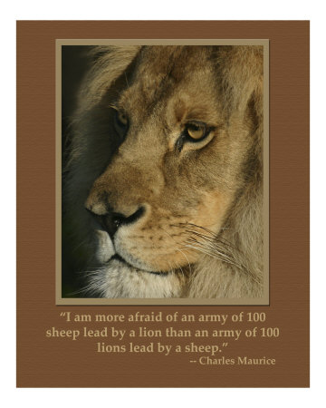

Slide 20
Leadership Implementation Strategy
Leadership requires a relentless determination to focus on:
Get the Big Picture Right
Uncover and Collaborate
Elicit Genuine Buy-in
Build
Trust
Focus on Progress
31

Slide 21




Implementation Strategy
Try to Avoid the Following when Leading Activities:
Assuming you have all the facts: “Look, its obvious that ….”
Assuming the other side is biased – Be independent but critical.
Assuming the other side’s motivations and intentions are obvious - common sense is not common.
Considering new ideas in isolation to your strategy – you will only seek to fragment your achievements and plans.
Micro-Managing.
Get the Big Picture Right
Uncover and Collaborate
Elicit Genuine Buy-in
Build
Trust
Focus on Progress
Instead:
Be curious: “Help me understand how you see the situation”.
Be humble: “What do I have wrong”.
Be open-minded: “Is there another way to explain this?”.
Use the full range of Leadership Styles.
Accept you don’t have a monopoly on good ideas.
32

Slide 22

Implementation Strategy
Try to Avoid the Following when Leading Activities:
Making open-ended offers: “What do you want?”.
Making unilateral offers: “I’d be willing to ….”
Simply agreeing to (re refusing) the other side’s demands.
Speaking first and declaring your hand.
Doing it all alone.
Get the Big Picture Right
Uncover and Collaborate
Elicit Genuine Buy-in
Build
Trust
Focus on Progress
Instead:
Ask “Why is that important to you”.
Propose solutions for critique: “Here’s a possibility – what might be wrong with it?”.
Establish a strategy of viral leadership.
Have answers for, Why, Why, Why.
Accept that you are only as strong as your weakest link.
33

Slide 23
Implementation Strategy
Try to Avoid the Following when Leading Activities:
Acting without gauging how your actions will be perceived and what the response will be.
Ignoring the consequences of a given action for future as well as current negotiations.
Monotonic leadership style.
Working alone.
Getting yourself sued.
Get the Big Picture Right
Uncover and Collaborate
Elicit Genuine Buy-in
Build
Trust
Focus on Progress
Instead:
Talk not just about the issues but about the negotiation process: “We seem to be at an impasse; perhaps we should spend some more time exploring our respective objectives and constraints.”
Slow down the pace: “I’m not ready to agree, because I’d prefer not to walk away either. I think this warrants further exploration.”
Issue warning without making threats: “Unless your willing to work with me towards a mutually accepted outcome, I can’t afford to spend more time negotiating.”
Create an audit trail.
34

Slide 24
Implementation Strategy
Try to Avoid the Following when Leading Activities:
Trying to “buy” a good relationship.
Offering concessions to repair breaches to trust, whether actual or only perceived.
Holding grudges.
Putting people into corners – always leave them space to wriggle and change their minds.
Breaking Trust (your word) – if circumstances force a change then ensure you communicate it well.
Get the Big Picture Right
Uncover and Collaborate
Elicit Genuine Buy-in
Build
Trust
Focus on Progress
Instead:
Explore how a break-down in trust may have occurred and how to remedy it.
Make concessions only if they are a legitimate way to compensate for losses owing to your non-performance or broken commitments.
Treat counterparts with respect, and act in ways that will command theirs.
Recognise that people don’t always play nicely.
Don’t try to be popular.
35

Slide 25
Implementation Strategy
Try to Avoid the Following when Leading Activities:
Threats: “You’d better agree, or else ….”
Arbitrariness: “I want it because I want it”.
Close mindedness: “Under no circumstances will I agree to – or even consider – that proposal”.
Drop the “Do it or Die” attitude.
Don’t play the short game.
Get the Big Picture Right
Uncover and Collaborate
Elicit Genuine Buy-in
Build
Trust
Focus on Progress
Instead:
Appeal to fairness: “We need to do the right things”
Appeal to logic and legitimacy: “I think this makes sense, because ….”
Consider constituent perspectives: “How can each of us explain this agreement to colleagues?”
Establish problems as being collective and not yours, alone.
Establish your measures and benchmarks – Keep measuring because what cant speak, cant lie.
36

Slide 26
Innovative Leadership
But what is Innovation?
Innovation can be described based on 5 types
  Individual and People – Improvement (acquire new knowledge or do things in different ways)
  Product – A new product (Washing Machine, iPod)
  Service – A new way of providing a service (Direct Line)
  Process – To improve efficiency:
    Implement IT/IS in businesses, services and management (e.g. e-Commerce, B2B, etc.)
    Moving assembly line in manufacturing or a theme park
  Organisational – Department, Process/Product, Team and Individual
42

Slide 27
Innovative Leadership
Innovation is about …
Knowledge
Transfer
Technology
Transfer
Social
Change
43

Slide 28
Innovative Leadership
Leading Innovation
You do not expect your team to be innovative if they do not know the direction in which they are heading
  Have a vision and appetite for change
  Set the course and give bearing for the future
Mission? Core purpose? Or Vision?...
  Whichever you choose, there should be one overarching statement that defines the direction for the ‘business’ and is understood and remembered
44

Slide 29
Innovative Leadership
Making an Impact as an Innovative Leader
A leaders must recognise and avoid five traps that he or she can fall into:
  Focusing too much on details
  Responding negatively to criticism
  Intimidating others
  Jumping to conclusions
  Micromanaging
If the team does well, the leader always gets the glory.
Work hard at ensuring you have the right team membership – Your success depends on it!
45

Slide 30

Six Thinking Hats – To Evaluate
Innovative Ideas or Formulate Teams
The information hat when people ask for more information or data to analyse the problem.
Expressing emotions hat to avoid hidden reasons for opposing or supporting a proposal (political motivation).
The optimism hat when everyone in turn has to say what is good about the proposal – Even if you hate the idea!
The hat of Pessimism when everyone has to find faults with the idea – Even if it was your idea and you are very proud of it!
The hat of Creativity for developing creative solutions to the identified problems.
A Leader’s hat to control the process – directing people to the appropriate hat as required:
- Contingency= Yellow / Black
- Ideas are dry = Green
46

Slide 31
Identifying Effective Leaders
Identifying Effective Leaders in your Institute
They are representative of their colleagues but not always popular
As communicators they are continually striving for more efficient and more inclusive communication structures, networks and processes
Usually skilled in the art of managing
They are analysts and scenario planners
They are advocates of the institution and cultivate relationships with various groups and individuals on campus and increasingly off-campus
47

Slide 32
Identifying Effective Leaders
Leadership Best Practices in UK Higher
Education – Sustaining Quality
The implementation and impact of policy, strategy and core processes will be more successful if closely coupled with leadership
Government requirements are best met if “policy and strategy” are seen as an integral part of the key responsibilities of leadership
48

Slide 33
Identifying Effective Leaders
Leadership Best Practices in UK Higher Education – Sustaining Quality
Leadership should be separated from policy, strategy, and process ownership as appears to be the case in the EFQM excellence model
49

Slide 34
Identifying Effective Leaders
Competencies for Effective Leadership in UK Higher Education
Attitude - What good leaders are
Self-aware
Sensitive to the views of others
Flexible
Open
Honest
Discrete
Visible, outgoing
Willing to be wrong/accept advise/support
Work to maintain academic credibility/respect
Behaviour - What good leaders do
Knowledge of university life
Knowledge – what good leaders know
Understand how the university system works
Understand academic process
Act as role models and motivate others
Think broadly/strategically
Engage with people
Listen to others
Consult with others
Negotiate
Act as Mentors and build teams
50

Slide 35
Theme 2: Leadership and Management
51

Slide 36
Leadership and Management
Leadership is about setting a new direction or vision for a group that they follow
Management controls or directs people/resources in a group according to principles or values that have already been established
A Leader is Followed and the Manager Rules
52

Slide 37
Leadership and Management
A leader is someone who people naturally follow through their own choice, whereas a manager must be obeyed
  A leader may have no organisational skills, but his vision unites people behind him
  A manager may only have obtained his position of authority through time and loyalty given to the university
53

Slide 38
Leadership and Management
Manager
Thinks Incrementally
Does things by the book
Leader
Thinks radically
Attracts loyalty
Follow own intuition
54

Slide 39
Leadership vs. Management
Leaders and managers can be differentiated based on some common activities – such as:
PLANNING
ORGANISING
DIRECTING WORK
CONTROLLING
55

Slide 40
Leadership vs. Management
Planning Phase
Leaders
Managers
Devising Strategies
Setting Directions
Creating Visions
Planning
Budgeting
Setting Budgets
Establishing Detailed Steps
Allocating Resources
56

Slide 41
Leadership vs. Management
Organising Phase
Leaders
Managers
Gets people on board for strategy
Facilitating effecting communication
Creating efficient networks
Creating structures
Jobs descriptions
Staffing
Hierarchy
Delegates
Training
57

Slide 42
Leadership vs. Management
Directing Work Phase
Leaders
Managers
Empowers people
Cheerleader
Solves problems
Negotiates
Brings to consensus
58

Slide 43
Leadership vs. Management
Controlling Phase
Leaders
Managers
Motivating people
Inspiring colleagues and staff
Provides a sense of accomplishment
Implements control systems
Performance measures
Identifies variances
Fixes variances
59

Slide 44
Leadership vs. Management
The Relationship of Vision, Strategies, Plans and Budgets
Vision
A sensible and appealing picture of the future
A logic of how the vision can be achieved
Specific steps and timetables to implement the strategies
Plans converted into financial projections and goals
Leadership
Creates
Strategies
Plans
Management
Creates
Budgets
60

